Slide 1
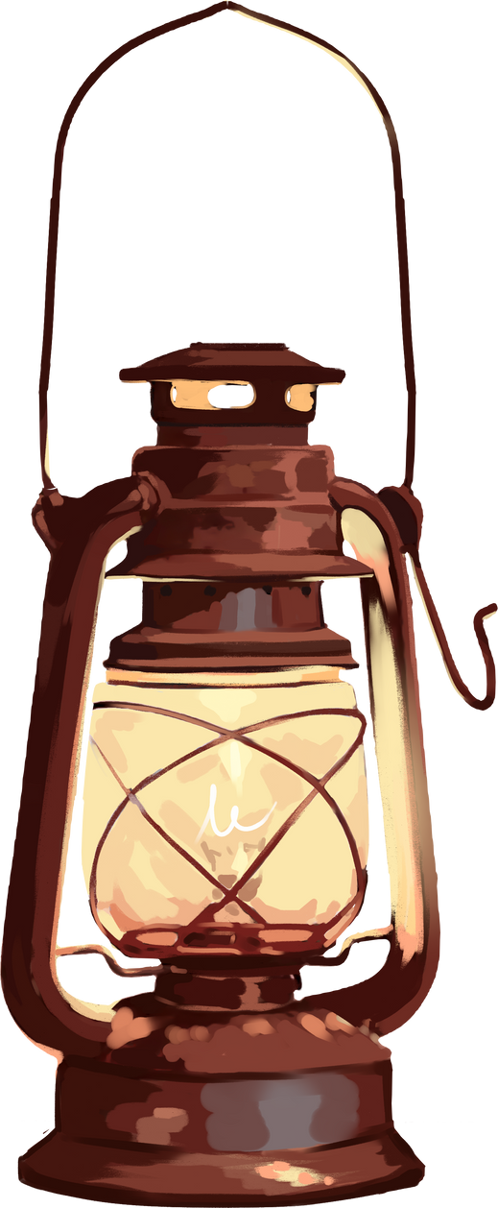

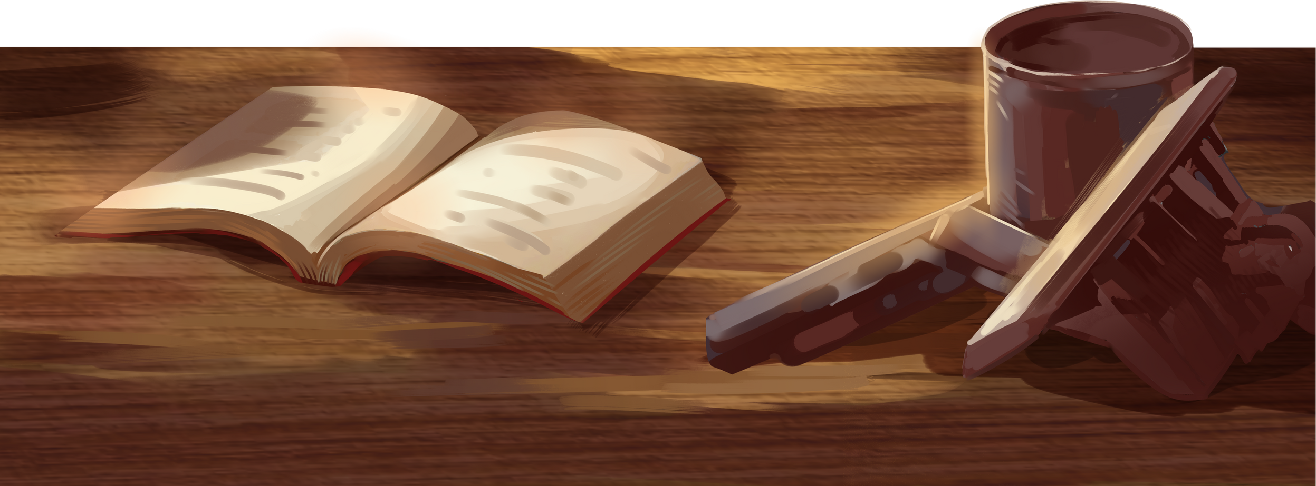
Arabic Letters
By Mauiza

Slide 2


What are Alphabets?
Alphabets are like little building blocks. We use them to make words! Just like Lego pieces make a tower, alphabets make sentences
Example: The word 'apple' has 5 letters: A, P, P, L, E. When these letters come together, they make the word apple

Slide 3
What Are Arabic Alphabets?
Arabic is another language like English. It’s special language because the Holy Quran was revealed in it. Like English, Arabic has its own letters.
Example: The word 'Quran' in Arabic uses Arabic alphabets:
(Kaf) ق ,(Ra) ر , (Alif) ا , (Noon) ن

Slide 4
What Is the Sound of Alphabets?
Alphabets have sounds we say with our mouth. Arabic alphabets are special because we know them by their sounds
Example: Like Arabic letter ا sounds like A and Arabic letter ب sounds like B

Slide 5

1st Letter
ا
(Alif)

Slide 6
2nd Letter
ب
(Baa)

Slide 7
3rd Letter
ت
(Taa)

Slide 8
4th Letter
ث
(Saa)

Slide 9
5th Letter
ج
(Geem)

Slide 10
6th Letter
ح
(Haa)

Slide 11
7th Letter
خ
(Khaa)

Slide 12
8th Letter
د
(Daal)

Slide 13
9th Letter
ذ
(Zaal)

Slide 14
10th Letter
ر
(Raa)

Slide 15
11th Letter
ز
(Zaa)

Slide 16
12th Letter
س
(Seen)

Slide 17
13th Letter
ش
(Sheen)

Slide 18
14th Letter
ص
(Suaad)

Slide 19
15th Letter
ض
(Duaad)

Slide 20
16th Letter
ط
(Tuaa)

Slide 21
17th Letter
ظ
(Zaaa)

Slide 22
18th Letter
ع
(Aeen)

Slide 23
19th Letter
غ
(Ghaeen)

Slide 24
20th Letter
ف
(Faa)

Slide 25
21st Letter
ق
(Qaaf)

Slide 26
22nd Letter
ك
(Kaaf)

Slide 27
23rd Letter
ل
(Laam)

Slide 28
24th Letter
م
(Meem)

Slide 29
25th Letter
ن
(Noon)

Slide 30
26th Letter
و
(Wow)

Slide 31
27th Letter
ه
(Haa)

Slide 32
28th Letter
ي
(Yaaa)

Slide 33
Alhamdulillah

